Slide 1

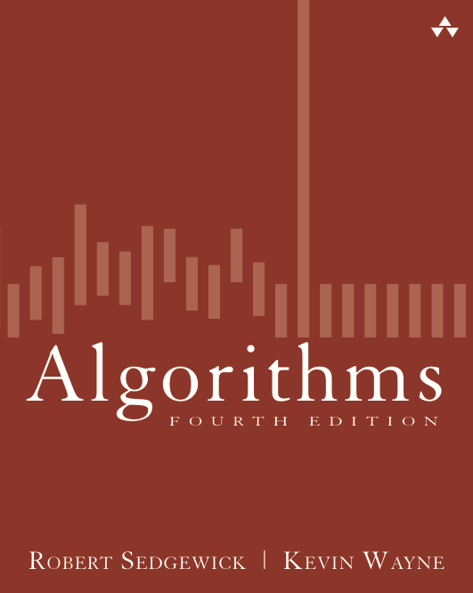
2.1 Insertion Sort Demo
Algorithms
Robert Sedgewick | Kevin Wayne
http://algs4.cs.princeton.edu

Slide 2









Insertion sort demo
In iteration i, swap a[i] with each larger entry to its left.

Slide 3
Insertion sort demo
In iteration i, swap a[i] with each larger entry to its left.
i
not yet seen

Slide 4
Insertion sort demo
In iteration i, swap a[i] with each larger entry to its left.
j
i
in ascending order
not yet seen

Slide 5
Insertion sort demo
In iteration i, swap a[i] with each larger entry to its left.
j
i
not yet seen

Slide 6
Insertion sort demo
In iteration i, swap a[i] with each larger entry to its left.
j
i
in ascending order
not yet seen

Slide 7
Insertion sort demo
In iteration i, swap a[i] with each larger entry to its left.
j
i
not yet seen

Slide 8
Insertion sort demo
In iteration i, swap a[i] with each larger entry to its left.
j
i
not yet seen

Slide 9
Insertion sort demo
In iteration i, swap a[i] with each larger entry to its left.
j
i
not yet seen

Slide 10
Insertion sort demo
In iteration i, swap a[i] with each larger entry to its left.
i
in ascending order
not yet seen

Slide 11
Insertion sort demo
In iteration i, swap a[i] with each larger entry to its left.
j
i
not yet seen

Slide 12
Insertion sort demo
In iteration i, swap a[i] with each larger entry to its left.
j
i
not yet seen

Slide 13
Insertion sort demo
In iteration i, swap a[i] with each larger entry to its left.
j
i
not yet seen

Slide 14
Insertion sort demo
In iteration i, swap a[i] with each larger entry to its left.
j
i
not yet seen

Slide 15
Insertion sort demo
In iteration i, swap a[i] with each larger entry to its left.
i
in ascending order
not yet seen

Slide 16
Insertion sort demo
In iteration i, swap a[i] with each larger entry to its left.
j
i
not yet seen

Slide 17
Insertion sort demo
In iteration i, swap a[i] with each larger entry to its left.
j
i
not yet seen

Slide 18
Insertion sort demo
In iteration i, swap a[i] with each larger entry to its left.
i
in ascending order
not yet seen

Slide 19
Insertion sort demo
In iteration i, swap a[i] with each larger entry to its left.
j
i
not yet seen

Slide 20
Insertion sort demo
In iteration i, swap a[i] with each larger entry to its left.
j
i
not yet seen

Slide 21
Insertion sort demo
In iteration i, swap a[i] with each larger entry to its left.
j
i
not yet seen

Slide 22
Insertion sort demo
In iteration i, swap a[i] with each larger entry to its left.
j
i
not yet seen

Slide 23
Insertion sort demo
In iteration i, swap a[i] with each larger entry to its left.
j
i
not yet seen

Slide 24
Insertion sort demo
In iteration i, swap a[i] with each larger entry to its left.
i
in ascending order
not yet seen

Slide 25
Insertion sort demo
In iteration i, swap a[i] with each larger entry to its left.
j
i
not yet seen

Slide 26
Insertion sort demo
In iteration i, swap a[i] with each larger entry to its left.
j
i
not yet seen

Slide 27
Insertion sort demo
In iteration i, swap a[i] with each larger entry to its left.
j
i
not yet seen

Slide 28
Insertion sort demo
In iteration i, swap a[i] with each larger entry to its left.
j
i
not yet seen

Slide 29
Insertion sort demo
In iteration i, swap a[i] with each larger entry to its left.
j
i
not yet seen

Slide 30
Insertion sort demo
In iteration i, swap a[i] with each larger entry to its left.
j
i
not yet seen

Slide 31
Insertion sort demo
In iteration i, swap a[i] with each larger entry to its left.
j
i
not yet seen

Slide 32
Insertion sort demo
In iteration i, swap a[i] with each larger entry to its left.
i
in ascending order
not yet seen

Slide 33
Insertion sort demo
In iteration i, swap a[i] with each larger entry to its left.
j
i
not yet seen

Slide 34
Insertion sort demo
In iteration i, swap a[i] with each larger entry to its left.
j
i
not yet seen

Slide 35
Insertion sort demo
In iteration i, swap a[i] with each larger entry to its left.
i
in ascending order
not yet seen

Slide 36
Insertion sort demo
In iteration i, swap a[i] with each larger entry to its left.
j
i

Slide 37
Insertion sort demo
In iteration i, swap a[i] with each larger entry to its left.
j
i

Slide 38
Insertion sort demo
In iteration i, swap a[i] with each larger entry to its left.
j
i

Slide 39
Insertion sort demo
In iteration i, swap a[i] with each larger entry to its left.
j
i

Slide 40
Insertion sort demo
In iteration i, swap a[i] with each larger entry to its left.
j
i

Slide 41
Insertion sort demo
In iteration i, swap a[i] with each larger entry to its left.
sorted

Slide 42
Selection sort demo
for (int i = 0; i < N; i++)
{
int min = i;
for (int j = i+1; j < N; j++)
{
if ( small(A, j, min) == true) min = j; // compare
}
swap(A, i, min); // exchange
}
Computational cost : ~ N²/ 2
Examination of the code reveals that, for each i from 0 to N -1, there is one exchange and N – 1- i compares, so the totals are N exchanges and (N -1) + (N -2) + . . . + 2 + 1+ 0 = N(N - 1) / 2 ~ N ²/ 2 compares.
(N -1) + (N-2) + (N-3) = N(N-1)/2
N ²/ 2 compares + N exchanges = N ²/ 2

Slide 43
Insertion sort demo
Proposition. To sort a randomly-ordered array with distinct keys, insertion sort uses ~ ¼ N ² compares and ~ ¼ N ² exchanges on average
InsertionSort(a[])
{
int N = size;
for (int i = 0; i < N; i++)
for (int j = i; j > 0; j--)
if (less(a[j], a[j-1])) // compare
swap(a, j, j-1); // exchange
else break;
}

Slide 44
Insertion sort demo
Proposition. To sort a randomly-ordered array with distinct keys, insertion sort uses ~ ¼ N ² compares and ~ ¼ N ² exchanges on average
InsertionSort(a[])
{
int N = size;
for (int i = 0; i < N; i++)
for (int j = i; j > 0; j--)
if (less(a[j], a[j-1])) // compare
swap(a, j, j-1); // exchange
else break;
}
[1, 3, 6, 6, 7], N =5
For i=0, 5-5, 0 compare
i=1, 5-4, 1 compare
2, 5-3, 2 compare.
3,
4, 4, N(N-1) / 2, worst case, average
BUT, breaks once “bigger than” found

Slide 45
Insertion sort demo
Proposition. To sort a randomly-ordered array with distinct keys, insertion sort uses ~ ¼ N ² compares and ~ ¼ N ² exchanges on average
InsertionSort(a[])
{
int N = size;
for (int i = 0; i < N; i++)
for (int j = i; j > 0; j--)
if (less(a[j], a[j-1])) // compare
swap(a, j, j-1); // exchange
else break;
}
Comparisons
Worst case : N(N-1) / 2, worst case, N ² /2
Best case : N-1 (already sorted)
Average : N ² /4 compares
Swaps: Same as Comparison
Worst case : N(N-1) / 2, worst case, N ² /2
Best case : 0 (already sorted)
Average : N ² /4 compares
Total Average : N ² /4 + N ² /4 = N ² /2

Slide 46
Insertion sort demo
Both, selection and insertion sorts, are quadratic running times, but insertion seems faster. Yes, it is faster theoretically
Insertion Sort : N ² /4 + N ² /4 = N ² /2
Selection Sort: N(N - 1) / 2 ~ N ² / 2
N IS SS
1000 0.019 0.02
2000 0.048 0.046
4000 0.2 0.196
8000 0.93 1.027
16000 3.115 3.23
32000 13.481 12.209
64000 52.853 55.485
128000 208.501 205.594
But, practically ☺
N IS SS
1000 0.002 0.002
2000 0.008 0.008
4000 0.033 0.03
8000 0.128 0.122
16000 0.551 0.479
32000 2.082 1.909
64000 8.372 7.8
128000 33.938 33.26
WHY?

Slide 47
Insertion sort demo
Both, selection and insertion sorts, are quadratic running times, but insertion seems faster. Yes, it is faster theoretically
Insertion Sort : N ² /4 + N ² /4 = N ² /2
Selection Sort: N(N - 1) / 2 ~ N ² / 2
N IS SS
1000 0.019 0.02
2000 0.048 0.046
4000 0.2 0.196
8000 0.93 1.027
16000 3.115 3.23
32000 13.481 12.209
64000 52.853 55.485
128000 208.501 205.594
But, practically ☺
N IS SS
1000 0.002 0.002
2000 0.008 0.008
4000 0.033 0.03
8000 0.128 0.122
16000 0.551 0.479
32000 2.082 1.909
64000 8.372 7.8
128000 33.938 33.26
WHY?
Because not all operations are equal.
Swap vs comparison

Slide 48
Insertion sort demo

Slide 49
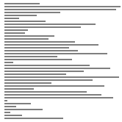
Insertion sort: animation
40 random items
algorithm position
in order
not yet seen
http://www.sorting-algorithms.com/insertion-sort

Slide 50

Insertion sort: animation
40 reverse-sorted items
algorithm position
in order
not yet seen
http://www.sorting-algorithms.com/insertion-sort

Slide 51
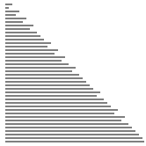
Insertion sort: animation
40 partially-sorted items
algorithm position
in order
not yet seen
http://www.sorting-algorithms.com/insertion-sort

